Slide 1

ITIL4 Model For IT Service Management.
By Group 5 Anna Backolars, Nengxi Peng, Ali Adrian Nasrat, Vehid Sumic

Slide 2

What is ITIL4 & SVS
World’s leading ITSM framework
Modern ITSM framework
Globally adopted standard
Focus on value creation
Service Value System
(Axelos Limited, 2019)

Slide 3

ITIL3 vs ITIL4
ITIL v3 is more built for processes and service lifecycle
ITIL4 is more flexible and holistic and is based on the Service Value System
(Axelos Limited, 2019)

Slide 4

Guiding Principles
Focus on value
Start where you are
Progress iteratively with feedback
Collaborate and promote visibility
Keep it simple and practical
Optimize and automate
(Axelos Limited, 2019)

Slide 5
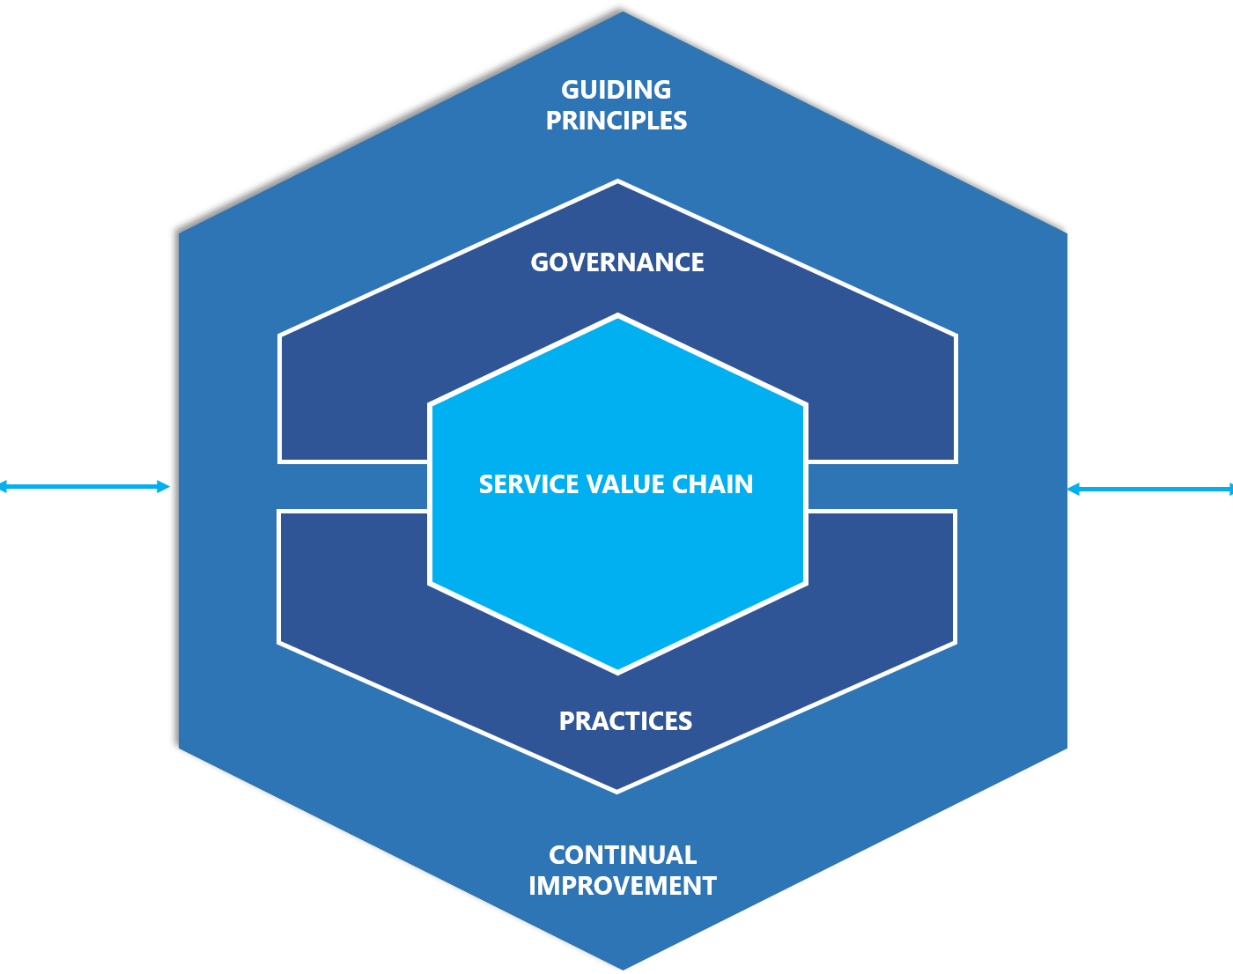
ITIL4 Service Value System (SVS)
Guiding Principles:
Core recommendations that help organizations make decisions Governance:
Structure and processes used to direct, control, and evaluate the organizations activities Service value chain:
The central model that shows how activities link together and turn demand into value through services Practices: Resources, processes, and capabilities that organizations use to preform work and achive objectives Continual improvement: An ongoing effort to improve services, practices, and all parts of the svs to increase value over time
(Axelos Limited, 2019; Axelos, 2019)​​

Slide 6
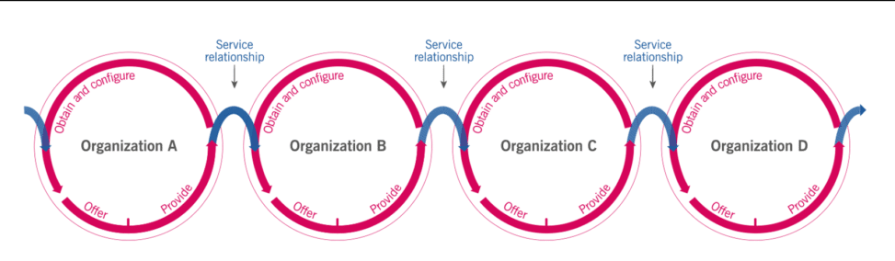
Value Co-creation
Collaboration between provider & consumer
Both sides add to value
Built on service relationships and trust
Feedback drives improvements
Focus on partnerships, not just delivery
( Axelos, 2019)​​

Slide 7

Flexibility of the SVS
Adapts quickly to change
Responds to new tech & customer needs
Handles unexpected disruptions
Connects all parts of ITIL4 into one system
Ensures continous improvement
(Axelos Limited, 2019)​

Slide 8
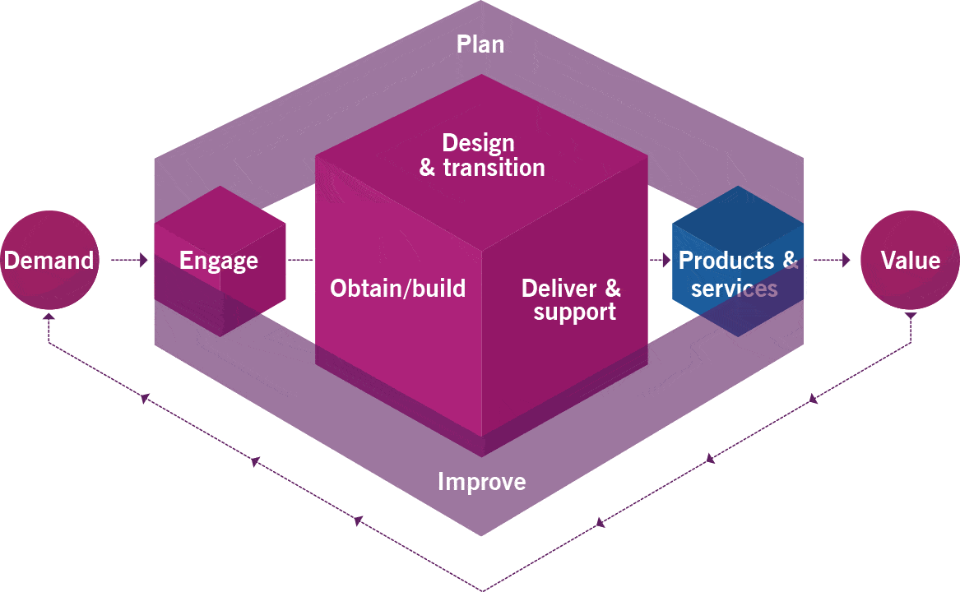
ITIL 4 Service Value Chain
Six steps: Plan, Improve, Engage, Design & Transition, Obtain/Build, Deliver & Support
Core model for creating and delivering services
Activities link together to turn demand into value
(Axelos Limited, 2019)

Slide 9
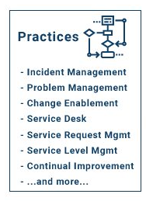
Integrating Practices into the Value Chain
Practices support every stage of the value chain
Ensure consistency, quality, and alignment
Change Enablement, Incident & Problem Management, Service Validation & Testing, Release Management
(Axelos, 2019; Thejendra, 2014)

Slide 10
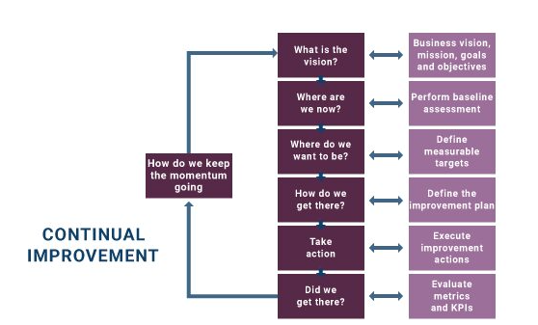
Ensuring Quality and Stability
Keeps IT systems stable and reliable
Enables continual improvement
Aligns IT services with business needs
(Axelos Limited, 2019; Axelos, 2019)

Slide 11

ITIL4 Key management practices
Incident Management Change Enablement Service Validation & Testing
( Axelos, 2019)​

Slide 12

Real Life Example
Incident Management: Airline booking website crashes, it gets logged, prioritized and restored quickly. Change Enablement Airline introduces a new online check in feature. Must be reviewed, approved and scheduled to avoid disruptions Service Validation and Testing Airline wants to launch new mobile app, IT team tests for instance, boarding pass scanning, seat selection and payment functions before launch
(Axelos Limited, 2019; Axelos, 2019)​

Slide 13

BENEFITS Improves system quality Stability Reduces risk Ensures business and IT stay aligned CHALLENGES Complex to implement Requires time and resources Resistance to change Risk of becoming too process focused
(Axelos, 2019; Thejendra, 2014)​

Slide 14
References
Axelos Limited. (2019). ITIL foundation: ITIL 4 edition. The Stationery Office.
Thejendra, B. S. (2014). Practical IT service management: A concise guide for busy executives (2:a uppl.). IT Governance Publishing.
Axelos. (2019). What is ITIL 4?. Axelos. https://ebookcentral.proquest.com/lib/dalarna/detail.action?docID=5 709789

